Slide 1
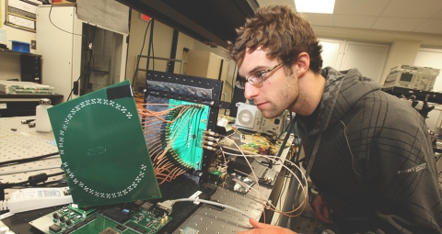
Computer Engineering
By: Sukhpreet, Damanveer

Slide 2
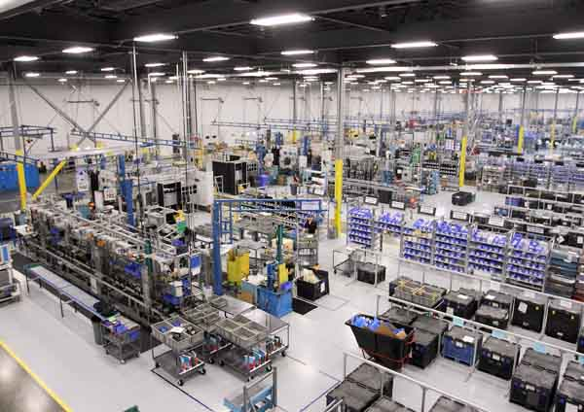
What it is?
Computer engineering is a discipline that integrates several fields of computer science and electronics engineering required to develop computer hardware and software
Consists of engineering, marketing, and manufacturing professionals. Computer software engineers usually work in cozy offices or laboratories with computers
People buying computer are the customer’s

Slide 3

Career Opportunities
Computer Engineer salary in Canada. The average Computer Engineer salary in Canada is $77,725 per year or $40 per hour. This is around 2.4 times more than the Median wage of the country.
There are over 5,000 jobs in Ontario alone.

Slide 4

Technology Connections
Computer software engineers develop, design, and test software. They construct, and maintain computer programs, as well as set up networks such as "intranets" for companies. Software engineers can also design or code new applications to meet the needs of a business or individual
Some types of computers used are Dell, etc

Slide 5

Program Requirements
University Requirements & College Requirements
Advanced Functions (MHF4U)
Calculus and Vectors (MCV4U)
Chemistry (SCH4U)
Physics (SPH4U)
English (ENG4U)

Slide 6

College Programs
Humber College, Sheridan College, Georgian College
All Types of programs like engineers, mechanics, medicals

